Slide 1

DEPARTEMENT OF INFORMATION SCIENCE & ENGINEERING FINAL YEAR PROJECT (2020-2021)
Project Title : Multimedia streaming and data sharing
Project Team Details : V K Sakthi Swarup(17BTRIS044), Jonnavaram Maheswar
Reddy(17BTRIS019), Gangireddy Hari Sainath
Reddy(17BTRIS018), Para Ashok(17BTRIS024)
Guide Name : Mathiyalagan, Assistant Professor, Dept of ISE, FET-JU

Slide 2
Contents:
Introduction
Literature survey
Limitations of current work
Objectives
Proposed System
Methodologies
System architecture
Screenshots
Conclusion
Future scope
Hardware and software requirements
References

Slide 3
Introduction
Streaming media is multimedia that is constantly received by and presented to an end-user while being delivered by a provider. The stream refers to the process of delivering or obtaining media in this manner. Streaming refers to the delivery method of the medium, rather than the medium itself. Distinguishing delivery method from the media distributed applies specifically to telecommunications networks, as most of the delivery systems are either inherently streaming (e.g. Radio, television, streaming apps) or inherently non-streaming (e.g. Books, video cassettes, audio CDs).
File sharing is the practice of distributing or providing access to digital media, such as computer programs, multimedia (audio, images and video), documents or electronic books. File sharing may be achieved in a number of ways. Common methods of storage, transmission and dispersion include manual sharing utilizing removable media, centralized servers on computer networks, world wide web-based hyperlinked documents, and the use of distributed peer-to peer networking.

Slide 4
Literature survey

Slide 5
Reference Papers
Sl No | Title | Authors | Year of Publication | Type of data | Methodologies | Limitations
1 | Design of a Media Stream Relay Engine on the Android OS | Huigwang Je, Dongwoo Kwon and Hongtaek Ju | 2015 | Research paper | Proposed as a solution to the problem of decreased network performance for large-scale multimedia delivery in a single wireless LAN environment. | It requires the administrator access which causes a vulnerability in the security
2 | Mobile Network Configuration for Large-scale Multimedia Delivery on a Single WLAN | Huigwang Je, Dongwoo Kwon, Hyeonwoo Kim, and Hongtaek Ju | 2014 | Research paper | The wireless network was configured in a structure for efficient multimedia streaming service in a single wireless LAN environment, and subsequently, the network performance was measured. | If the number of connected devices increases then data transfer rate decreases.

Slide 6
Sl No | Title | Authors | Year of Publication | Type of data | Methodologies | Limitations
3 | P2P Networking: An Information-Sharing Alternative | Manoj Parameswaran, Anjana Susarla Andrew, B. Whinston | 2001 | Research paper | Uses client-server technologies that incorporate networking as an ancillary, value-added feature. Peer-to-peer computing that offers a radically new way of isolating and focusing on the networking aspect as the business model’s mainstay. | If all the clients simultaneously request data from the server, it may get overloaded. This may lead to congestion in the network
4 | In-Kernel Relay for Scalable One-to-Many Streaming | Ying-Dar Lin, Chia-Yu Ku, Yuan-Cheng Lai, Chia-Fon Hung | 2013 | Research paper | The in-kernel One-to-Many Streaming Splicing (OMSS) relay method can help improve the relay data paths of critical nodes to reduce computing power for UDP and TCP streams and enhance the subscriber capacity. | Uses OMSS method in which manipulation of data can be done easily

Slide 7
Sl No | Title | Authors | Year of Publication | Type of data | Methodologies | Limitations
5 | A Transport Protocol for Supporting Multimedia Streaming in Mobile Ad Hoc Networks | Zhenghua Fu, Xiaoqiao Meng, and Songwu Lu | 2003 | Research paper | The design and implementation of a transmission control protocol (TCP)-friendly transport protocol for ad hoc networks. Our key design novelty is to perform multimetric joint identification for packet and connection behaviors based on end-to-end measurements | TCP protocol provides reliable data delivery support but high latency problems arises
6 | Collaborative Streaming-based Media Content Sharing in WiFi-enabled Home Networks | Hayoung Yoon, JongWon Kim | 2010 | Research paper | Proposed DOMS (Decentralized collaborative Media content Streaming) that realizes flexible media content sharing by exploiting collaborative segment-based streaming amongst WiFi devices via the temporarily-established direct links | DOMS requires a stable connection and more processing

Slide 8
Sl No | Title | Authors | Year of Publication | Type of data | Methodologies | Limitations
7 | A Case for End System Multicast | Yang-hua Chu, Sanjay G. Rao, Srinivasan Seshan and Hui Zhang | 2002 | Research paper | Explored an alternative architecture that we term End System Multicast, where end systems implement all multicast related functionality including membership management and packet replication. This shifting of multicast support from routers to end systems has the potential to address most problems associated with IP Multicast. | IP Multicast is the first significant feature that has been added to the IP layer since its original design and most routers today implement IP Multicast. Despite this, IP Multicast has several drawbacks that have so far prevented the service from being widely deployed.
8 | A Distributed Search Service for Peer-to-Peer File Sharing in Mobile Applications | Christoph Lindemann and Oliver P. Waldhorst | 2002 | Research paper | Enabling resource-effective searching for files distributed across mobile devices based on simple queries | It searches all the data in the device which makes the privacy effected

Slide 9
Sl No | Title | Authors | Year of Publication | Type of data | Methodologies | Limitations
9 | A Special-Purpose Peer-to-Peer File Sharing System for Mobile Ad Hoc Networks | Alexander Klemm, Christoph Lindemann, and Oliver P. Wald horst | 2003 | Research paper | a special purpose system for searching and file transfer tailored to both the characteristics of MANET and the requirements of peer-to-peer file sharing | The researchers proposed the use of this structure for audio; it is not suitable for high-capacity media such as streaming video
10 | On-demand Video Streaming in Mobile Opportunistic Networks | Hayoung Yoon, Jong Won Kim, Feiselia Tan, and Robert Hsieh | 2008 | Research paper | Proposed MOVi (Mobile Opportunistic Video-on-demand), a mobile peer-to-peer video-on-demand application based on ubiquitous WIFI enabled devices such as smartphones and Ultra Mobile PCs | It exploits sparsely distributed access points, user mobility , fluctuating to provide a high bitrate on-demand video streaming service.
11 | An Efficient Implementation of File Sharing∗ Systems on the Basis of WiMAX and Wi-Fi | Jingyuan Li, Liusheng Huang, Weijia Jia, Mingjun Xiao and Peng Du | 2006 | Research paper | Proposed an efficient algorithm for P2P file sharing systems based on WiMAX mesh mode and Wi-Fi technologies | WiMAX is very power intensive technology and requires strong electrical support

Slide 10
Sl No | Title | Authors | Year of Publication | Type of data | Methodologies | Limitations
12 | A Data-driven Overlay Network for Peer-to-Peer Live Media Streaming | Xinyan Zhang, Jiangchuan Liut, Bo Lis, and Tak-Shng Peter Yum | 2005 | Research paper | a Data-driven Overlay Network for live media streaming. The core operations in DOTNet are very simple: every node periodically exchanges data availability information with a set of partners, and retrieves unavailable data from one or more partners, or supplies available data to partners. | Can be used low-latency protocols for data transfer instead of high latency protocols
13 | An Efficient Peer-to-Peer File Sharing Exploiting Hierarchy and Asymmetry | Gisik Kwon Kyung D. Ryu | 2003 | Research paper | Peer-to-peer Asymmetric file Sharing System (PASS), a novel approach to P2P file sharing, which accounts for the different capabilities and network locations of the participating machines. | Some peer-to-peer (P2P) file sharing operation models over asymmetric networks have several shortcomings that may affect system and network performance

Slide 11
Sl No | Title | Authors | Year of Publication | Type of data | Methodologies | Limitations
14 | File Sharing System in Wireless Home Environment | Yongjia Liu, Yong Sun, Qing Liao, Xiangming Wen | 2010 | Research paper | a system aiming to enable family member with mobile phone to share files with other family members with a PC at home no matter whether the mobile phone user is outside the home environment or inside the home environment | Uses a protocol similar to DLNA, which trades- of low latency with quality
15 | A Social-Network-Aided Efficient Peer-to-Peer Live Streaming System | Haiying Shen, Yuhua Lin, and Jin Li | 2014 | Research paper | Proposed a Social-network-Aided efficient live streaming system (SAVE). SAVE regards users’ channel switching or multichannel watching as interactions between channels | Cannot be uses where internet services are poor
16 | Video and Audio Streaming Issues in Multimedia Application | Puja Smiti, Swapnita Srivastava | 2018 | Research paper | Different streaming technique has been analyzed to procure the applicability and optimization of audio/video has been done through FFmpeg software. | FFmpeg does not ensure bitrate consistency across a set of files

Slide 12
Sl No | Title | Authors | Year of Publication | Type of data | Methodologies | Limitations
17 | A Survey on Various File Sharing Methods in P2P Networks | Vimal S, Srivatsa S K | 2017 | Research paper | discovers the different file sharing methods and important concerns that communicate to peers systems and discussing about the various study actions of Peer-to-Peer file systems | DLNA protocol is used, which trades- of low latency with quality
18 | A Study of Live Video Streaming System for Mobile Devices | Jiushuang Wang, Weizhang Xu, Jian Wang | 2016 | Research paper | describes a mobile video live streaming system with Wi-Fi/4G mobile phone to capture video and disseminate. Availability of mobile video live streaming system is given and then a mobile video live streaming system based on streaming media technology is designed and realized | Requires high speed internet services

Slide 13
Sl No | Title | Authors | Year of Publication | Type of data | Methodologies | Limitations
19 | Cool-SHARE: Offload Smartphone Data By Sharing | Nikki Broch Ashton and Qi Zhang | 2014 | Research paper | Cool-SHARE is proposed and implemented on Android. It is an app for seamlessly sharing apps over short-range links with limited cellular control and can be extended for multimedia data sharing | It works for short range in which interrupts cannot be tolerated
20 | Streaming Video over the Internet: Approaches and Directions | Dapeng Wu, Yiwei Thomas Hou, Wenwu Zhu, Ya-Qi, ZhangJon M. Peha | 2001 | Research paper | cover six key areas of streaming video. Specifically, we cover video compression, application-layer QoS control, continuous media distribution services, streaming servers, media synchronization mechanisms, and protocols for streaming media. For each area, we address the particular issues and review major approaches and mechanisms. | Interruption in the internet services can stop the streaming.

Slide 14
Sl No | Title | Authors | Year of Publication | Type of data | Methodologies | Limitations
21 | Robust Super-Peer-Based P2P File-Sharing Systems | Jenn-Wei Lin and Ming-Feng Yang | 2010 | Research paper | An efficient approach for improving file availability in super-peer-based peer-to-peer (P2P) file-sharing systems. In the super-peer-based P2P file-sharing system, peers are organized into multiple groups | Can be used advanced protocols for effective transmission
22 | Enhanced UPnP QoS Architecture for Network-adaptive Streaming Service in Home Networks | HyunYong Lee, SungTae Moon and JongWon Kim | 2007 | Research paper | an enhanced UPnP QoS architecture is proposed to support network-adaptive media streaming in home networks | Interruption in network provides loss of data

Slide 15
Limitation of current work
Most of the applications available today are delivering the content through a medium called internet which may not be available for every device.
Most of the devices may not be having enough storage to store the multimedia in their devices.
For streaming, most of the users uses screen mirroring which makes both the devices involved.

Slide 16
Objectives
To implement an android application which helps in steaming and sharing of data between the devices connected through a local network.
To implement seamless data streaming and sharing between the android devices connected through the local network.
To implement the application in devices having android versions 8 and above.
To implement the connection between the host and the client using the feature wifi direct.
To implement http server that is established in the host device for steaming the multimedia files.

Slide 17
Proposed System
The idea of the android application of steaming files on the devices connected through any local network (can be connected using wi-fi, Bluetooth, wi-fi-direct) is to play/read the files on the other device using the connection.
The sharing option is also available for transfer the media files between the devices within the connection.

Slide 18
Methodology
Streaming
The streaming part of the application uses the low-latency streaming protocol over traditional streaming protocols which are emphasizes on quality of the content
HTTP based streaming protocol called low-latency HLS is used in streaming process of the application
The mini HTTP server created in the host device and low-latency HLS protocol facilitates the delivery of the data between the devices
File transferring
The sharing feature of the application uses peer-to-peer(p2p) file transfer protocol
I.E., FTP protocol ,and transfers the data between devices
Application uses the wifi-direct feature to facilitate data transfer between the devices

Slide 19
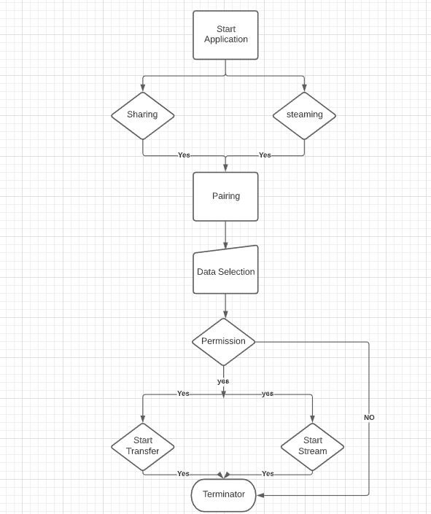
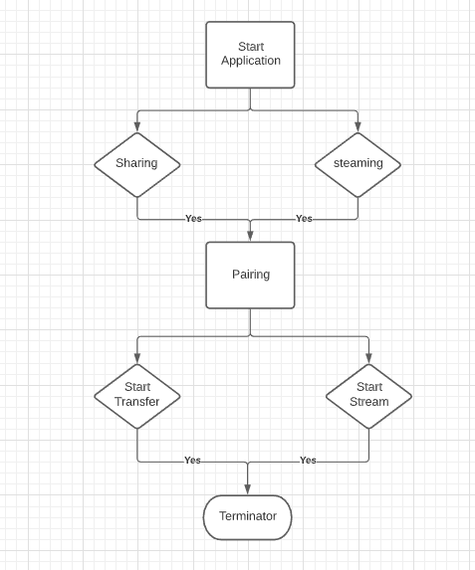
Flow chart
HOST:
CLIENT:

Slide 20
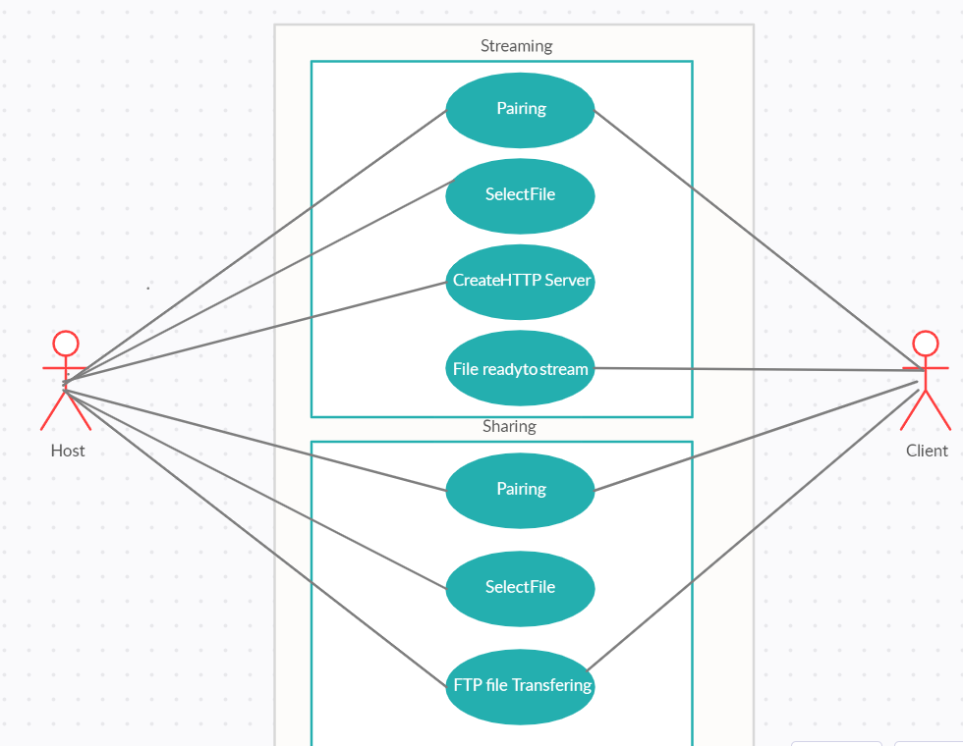
Use case diagram

Slide 21
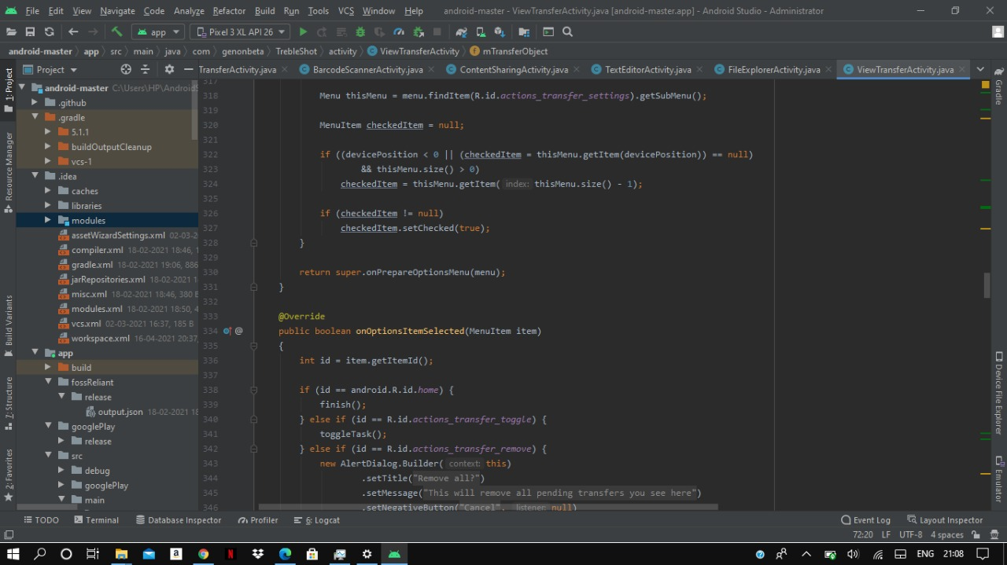
Screenshots

Slide 22
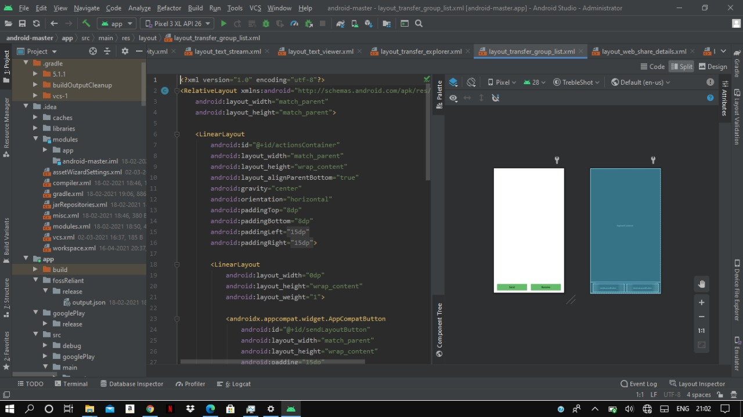

Slide 23
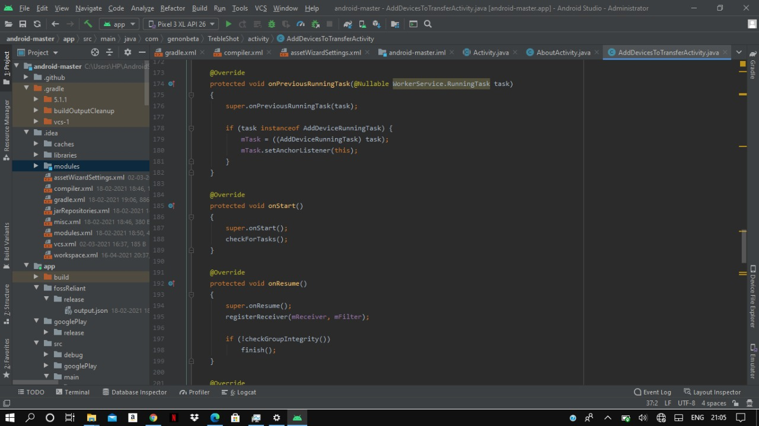

Slide 24
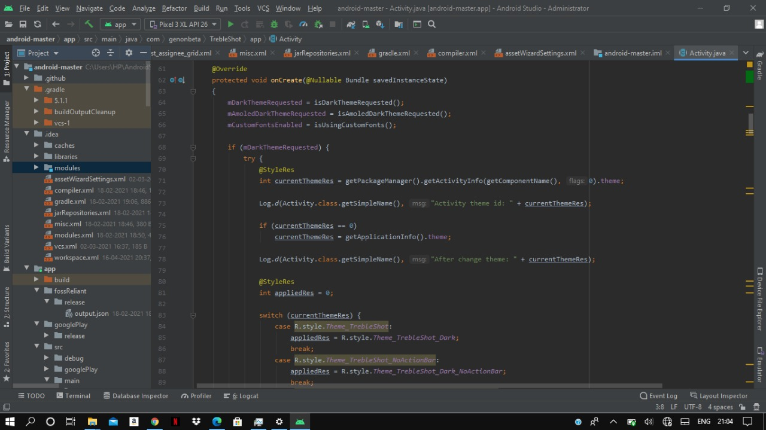

Slide 25
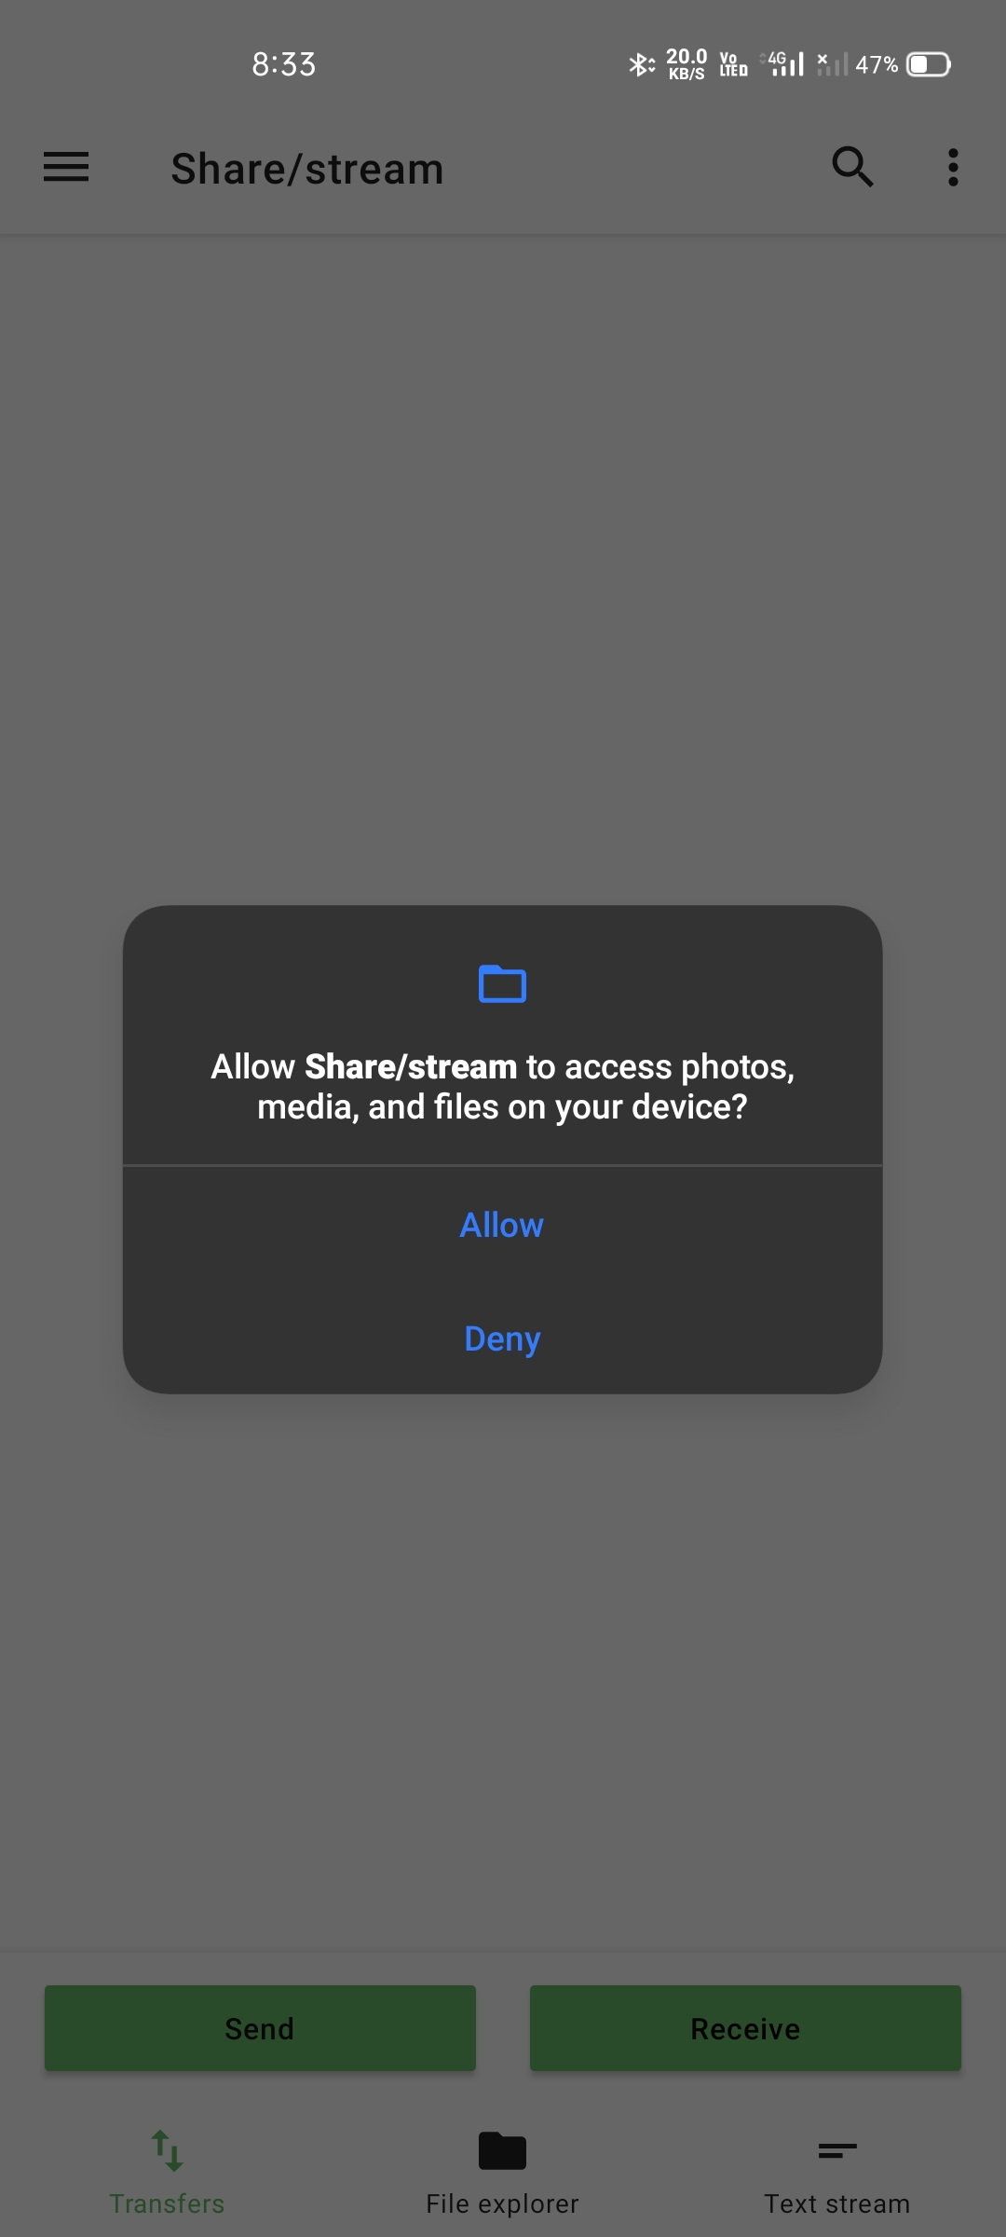
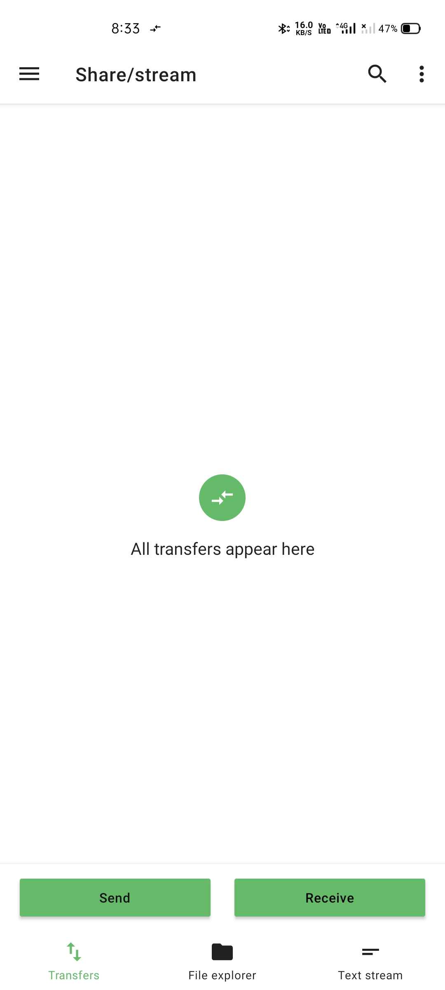
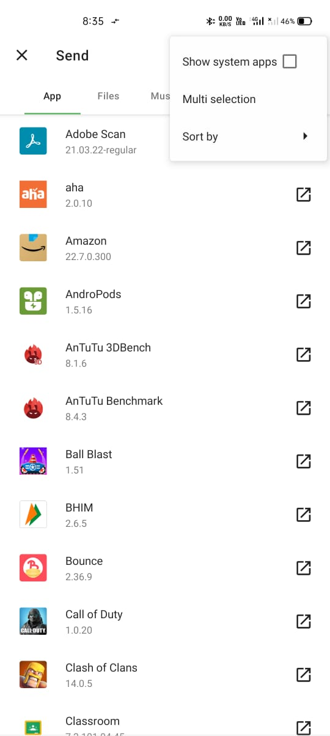
Flow of application

Slide 26
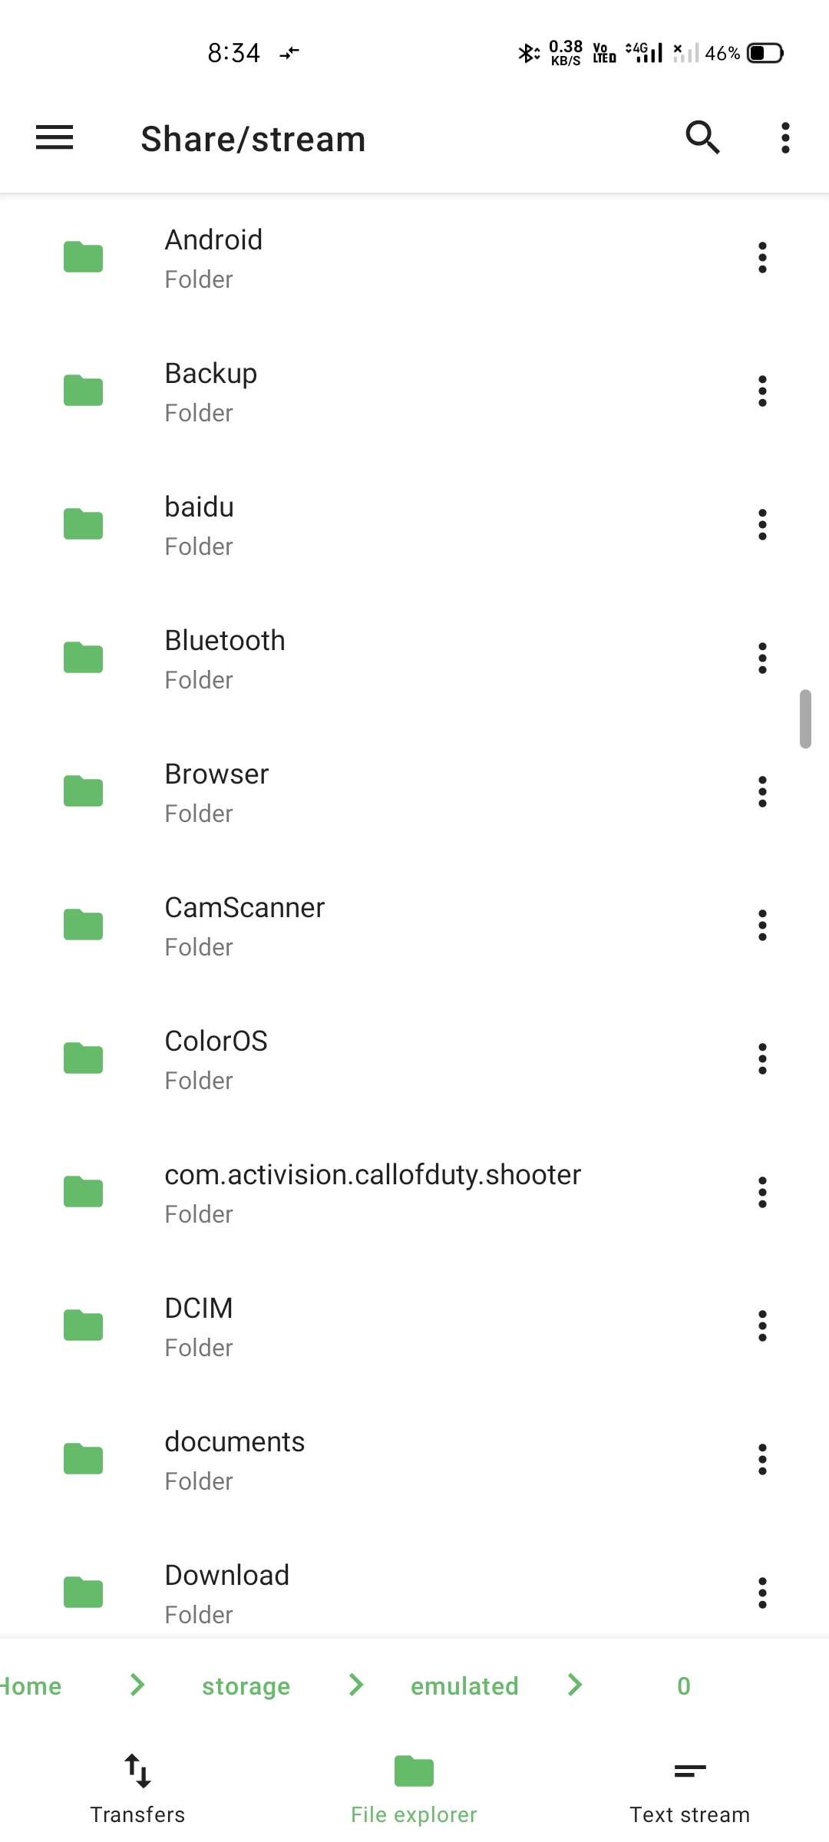
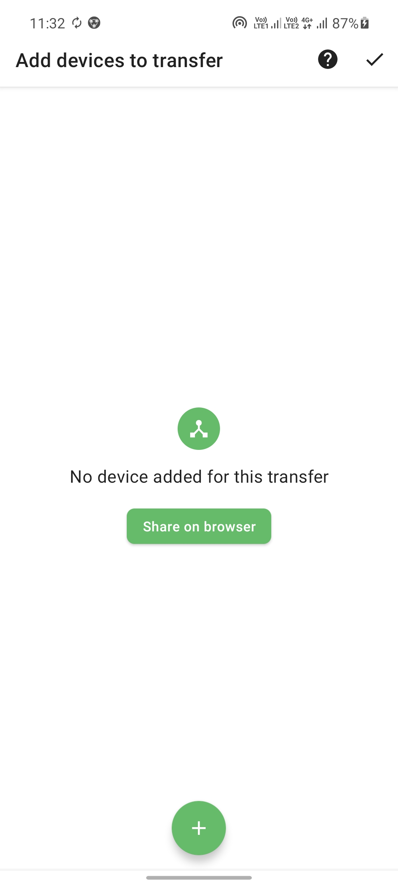
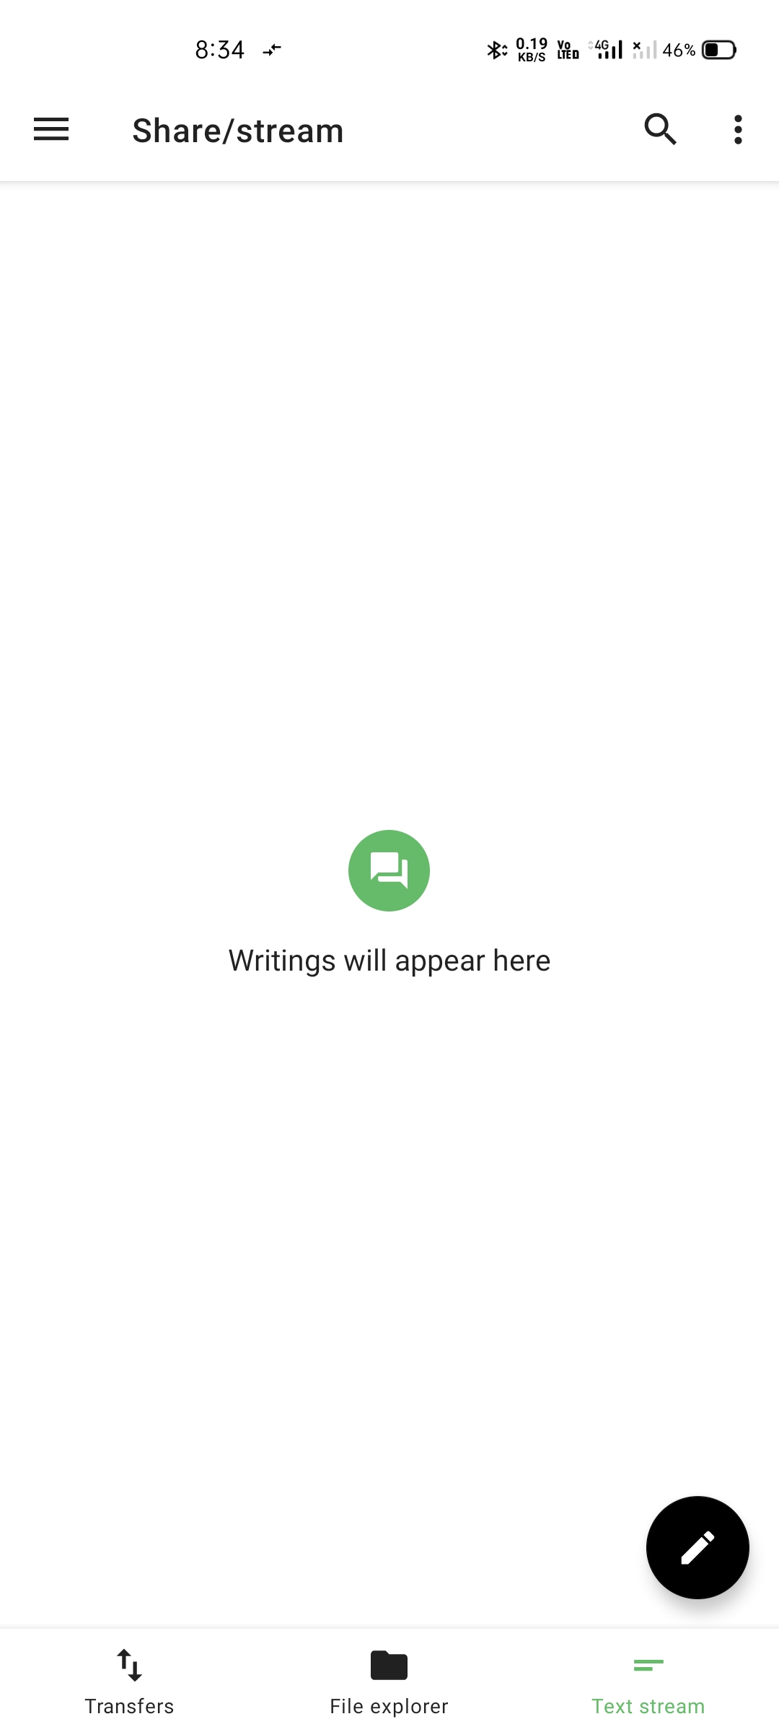

Slide 27
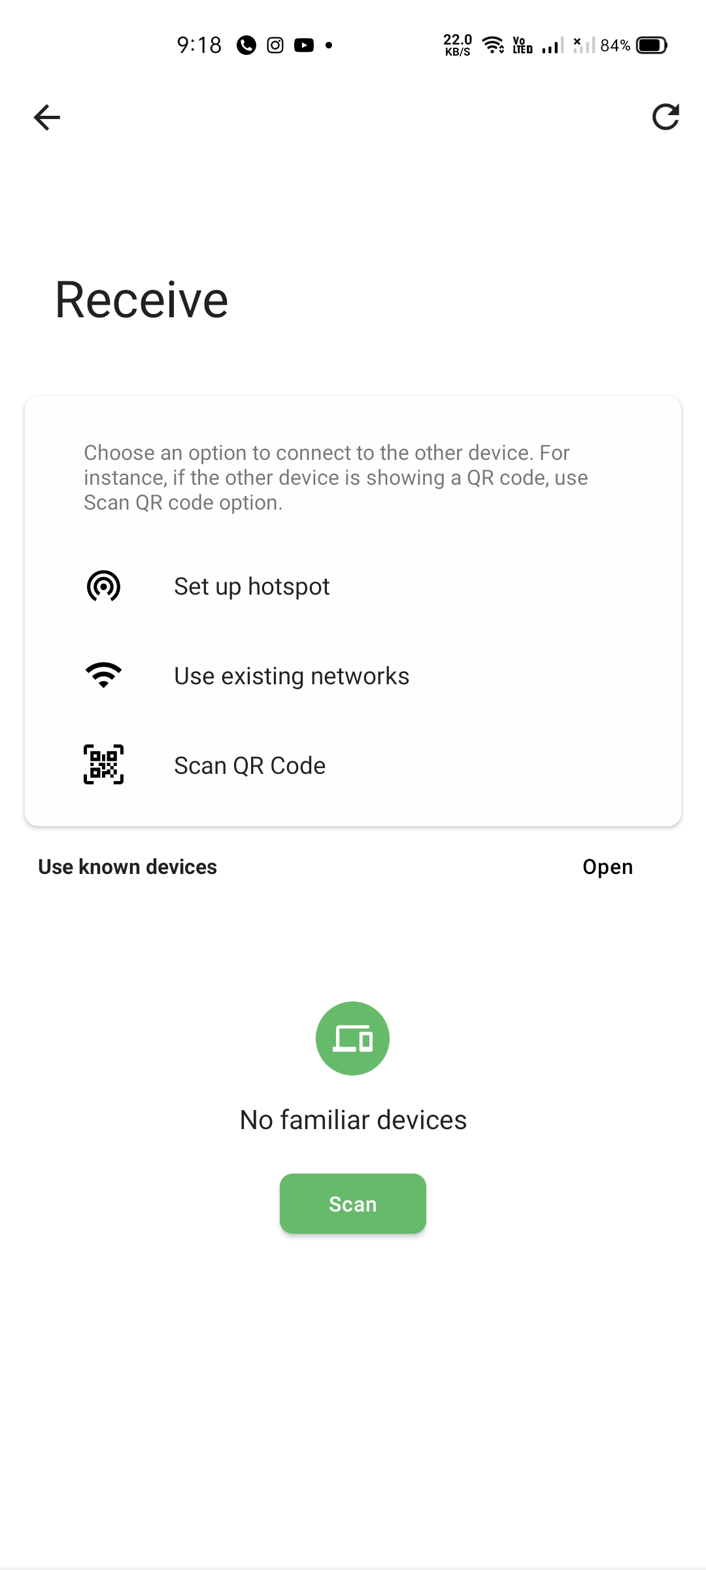
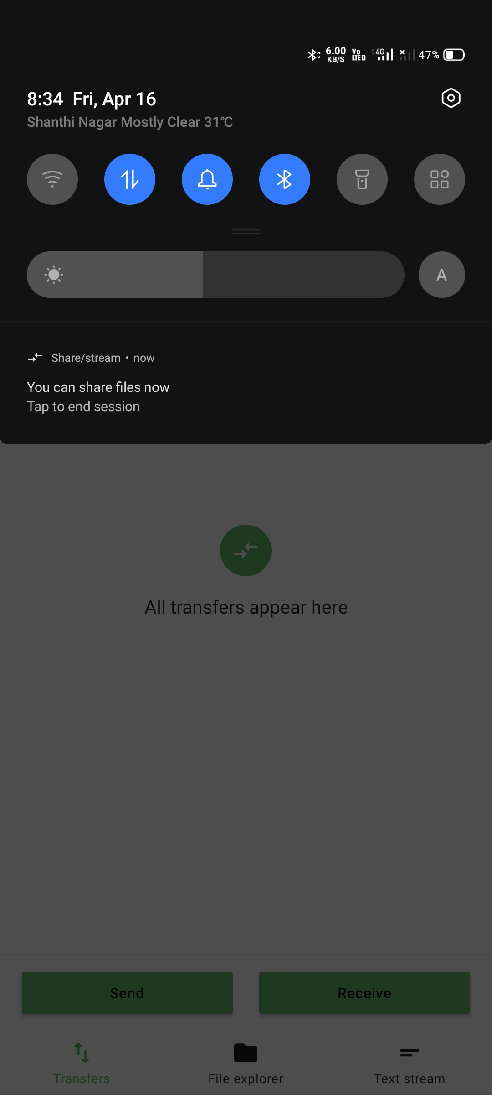

Slide 28
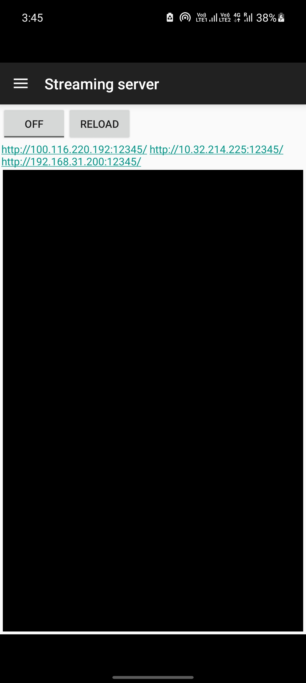
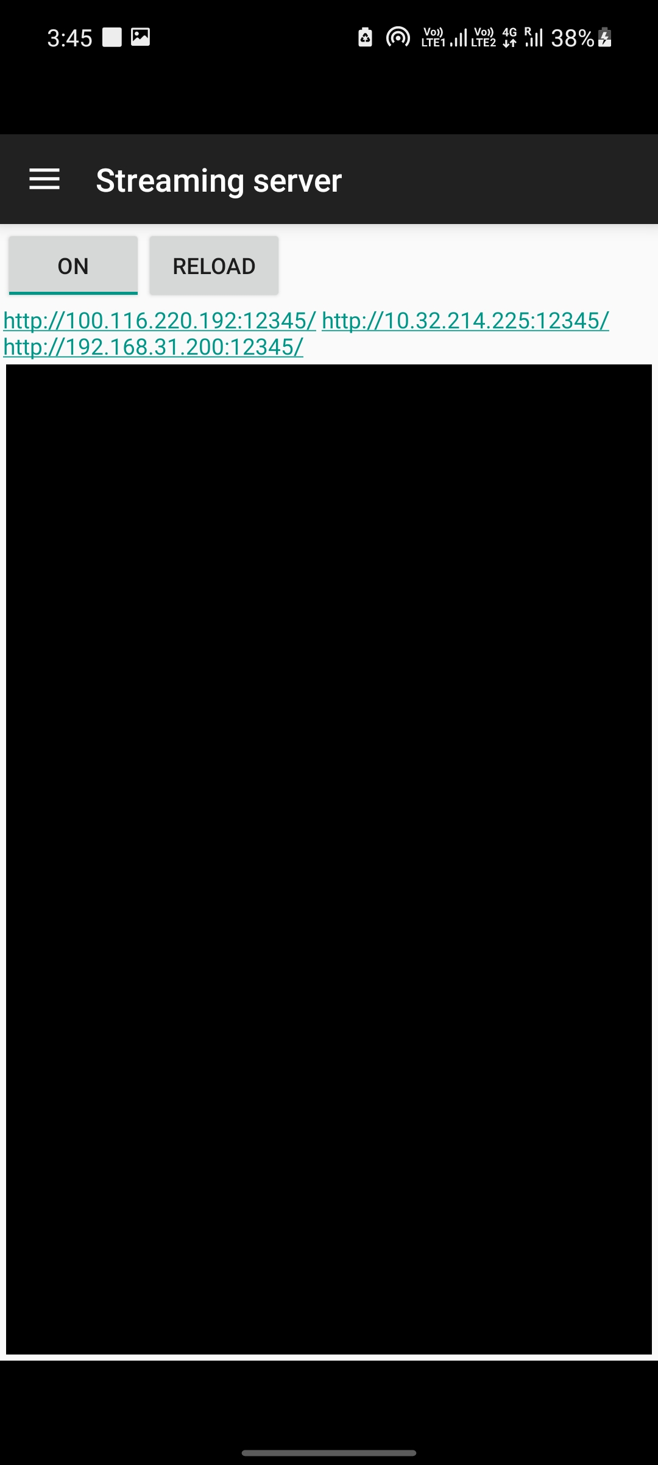
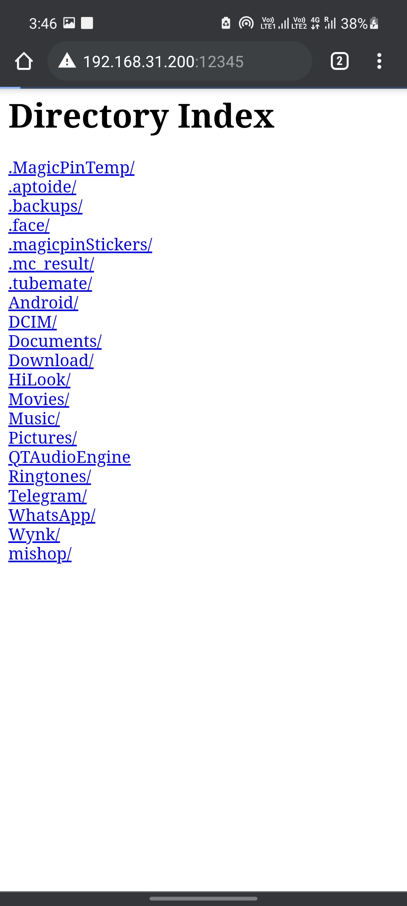

Slide 29
Hardware/Software Requirements
Operating system : Windows
Developing tools : Android studio
Developing language : Java, XML
Methodology : HTTP based server, HLS low latency protocol
Deployment : Android (8.0 & above)

Slide 30
Conclusion
We have studied different methodologies for the multimedia streaming and sharing which helps the users to share data over and over again. Despite of having many applications to do so it is very costly and time taking. Our application will let the user to transfer the multimedia data over a local connection such as wifi-direct seamlessly. The application does not require an internet connection.

Slide 31
Future scope
Further, we are trying to use different protocols other than HLS protocol for better efficiency.
Improvement of user interface is on the way.
We will try to implement new features such as chatting while the files are being transferred.
We will try to implement to stream larger files by using different protocols such as sftp.

Slide 32
References
[1] g. Eason, B. Noble, and I.N. Sneddon, “on certain integrals of lipschitz-hankel type involving products of bessel functions,” phil. Trans. Roy. Soc. London, vol. A247, pp. 529-551, april 2018.
[2] j. Clerk maxwell, A treatise on electricity and magnetism, 3rd ed., Vol. 2. Oxford: clarendon, 1892, pp.68-73.
[3] i.S. Jacobs and C.P. Bean, “fine particles, thin films and exchange anisotropy,” in magnetism, vol. Iii, g.T. Rado and H. Suhl, eds. New york: academic, 1963, pp. 271- 350.
[4] y. Yorozu, M. Hirano, K. Oka, and Y. Tagawa, “electron spectroscopy studies on magneto-optical media and plastic substrate interface,” IEEE transl. J. Magn. Japan, vol. 2, pp. 740-741, august 2015
[5] t. Shiao-li and E. C. Cheng, "PIANO: a power saving strategy for cellular/vowlan dual-mode," wireless network, vol. 14, pp. 683-698, 2008.
[6] a. Yuvraj, C. Ranveer, W. Alec, B. Paramvir, C. Kevin, and G. Rajesh, "wireless wakeups revisited: energy management for voip over wi-fi smartphones," in proceedings of the 5th international conference on mobile systems, applications and services; san juan, puerto rico: ACM, 2007.

Slide 33
Thank you!

